Slide 1
Optimized Artificial Intelligence Techniques for Enhanced Color Image Retrieval
Submitted in the partial fulfillment for the award of the degree of
BACHELOR OF ENGINEERING
IN
NAME_OF_SPECIALIZED_BRANCH
Submitted by:
Somya Khandelwal-22BAI71222
Gargi Khandelwal-22BAI71214
Chahat Gupta-22BAI71219
Under the Supervision of:
Prof. Sant Kumar Mourya
Department of AIT-CSE
DISCOVER . LEARN . EMPOWER

Slide 2
OUTLINE
Introduction to Project
Problem Formulation
Objectives of the work
Methodology used
Results and Outputs
Conclusion
Future Scope
References

Slide 3
INTRODUCTION
The rapid rise of digital images has created an urgent demand for smarter retrieval systems.
Keyword-based search is outdated since it depends on manual tagging, which is slow, inconsistent, and subjective.
Keyword-based search is outdated since it depends on manual tagging, which is slow, inconsistent, and subjective.
Current CBIR methods struggle with large feature dimensions, redundant data, and weak similarity measures.
An optimized AI-driven system is required to improve both accuracy and efficiency.

Slide 4
INTRODUCTION
A combined or hybrid feature approach creates a richer image description but also introduces excessive and unnecessary data.
To overcome this, metaheuristic optimization methods such as Genetic Algorithm, Firefly Algorithm, and Swarm Intelligence are applied.
These techniques help identify the most important features, cut down data size, and improve retrieval accuracy.
The result is a system that delivers higher precision, quicker search results, and better scalability.
Finding similar images in massive databases is complex because multiple visual aspects must be considered.

Slide 5
PROBLEM FORMULATION
Image retrieval means finding the closest visual matches to a query image from a massive database.
The challenge grows because images are described by many features (color, texture, shape), which together create large, high-dimensional data.
Using all these features directly is inefficient, as it slows the process and brings in redundancy.
Some features are irrelevant or even harmful, adding noise instead of improving accuracy, so smart selection is necessary.

Slide 6
PROBLEM FORMULATION
Traditional feature selection methods often fail, which is why advanced optimization techniques like Genetic Algorithm, Firefly Algorithm, and Swarm Intelligence are needed.
These algorithms can explore the search space globally and adaptively pick the best subset of features for retrieval.
For real-world use, the system must handle millions of images while staying reliable against variations like lighting, scale, noise, and orientation.
The research frames this as a multi-objective problem: reducing dimensionality, improving accuracy (precision/recall), and lowering computational costs.
The ultimate aim is to design an AI-powered hybrid feature optimization framework that pushes CBIR systems toward higher accuracy, speed, and scalability.

Slide 7
OBJECTIVES
The research centers on building an AI-powered framework that improves color image retrieval through optimized hybrid features.
A combined representation of color, texture, and shape will be developed to capture images more fully and avoid missing relevant matches.
Advanced optimization techniques (GA, FA, SI) will be explored to filter out redundant data, keep only the most useful features, and speed up retrieval.
Experiments on well-known benchmark datasets will be carried out to compare different optimization strategies and assess their accuracy, efficiency, and scalability.

Slide 8
OBJECTIVES
A specialized indexing and similarity mechanism will be designed to enable fast search and low latency in large-scale databases.
The system will be made robust enough to handle variations such as changes in lighting, orientation, size, and noise, ensuring real-world adaptability.
The framework will serve both academic and industrial needs by showing how optimization-driven CBIR can provide a better balance between accuracy and efficiency than conventional or deep learning-only approaches.
Overall, the project aims to deliver a practical, scalable, and industry-ready CBIR solution that advances visual search technology.

Slide 9
METHODLOGY USED
The system is designed as a step-by-step pipeline to ensure fast and accurate image retrieval.
Images from standard datasets are resized, normalized, and denoised to create a consistent and clean input.
Color, texture, and shape details are captured and combined into a single hybrid descriptor for complete image representation.
Advanced algorithms like Genetic Algorithm, Firefly Algorithm, and Particle Swarm Optimization are applied to pick the most relevant features and remove redundancy.

Slide 10
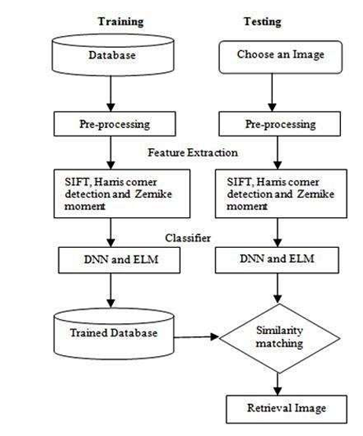
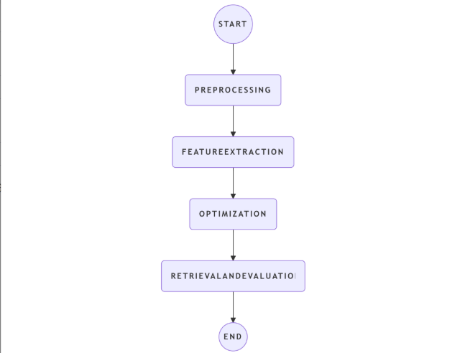
FLOWCHART OF METHODOLOGY

Slide 11
METHODOLOGY USED
Optimized features are indexed, and similarity between images is calculated using metrics like Euclidean, Cosine, or Chi-square distances to retrieve the closest matches.
The system is assessed using accuracy metrics such as Precision, Recall, F1-score, Mean Average Precision, and retrieval time; different optimization methods are compared for effectiveness.
The framework is implemented in Python and MATLAB and validated on multiple datasets to ensure it works efficiently in real-world scenarios.

Slide 12
RESULTS
Proposed an AI-driven CBIR framework that integrates color, texture, and shape features into a hybrid representation.
Employs metaheuristic optimization algorithms (Genetic Algorithm, Firefly Algorithm, Swarm Intelligence) for effective feature selection and dimensionality reduction.
Reduces redundant and irrelevant features, resulting in higher retrieval accuracy, lower computational cost, and better scalability for large datasets.
Leverages multiple complementary descriptors rather than relying on a single feature or simple matching, improving robustness against illumination, scaling, and noise.
Ensures efficient performance in real-time applications while maintaining system reliability.
Validated through experiments on benchmark datasets like Corel-1000, Caltech-256, and ImageNet subsets to demonstrate superiority over conventional CBIR systems.

Slide 13
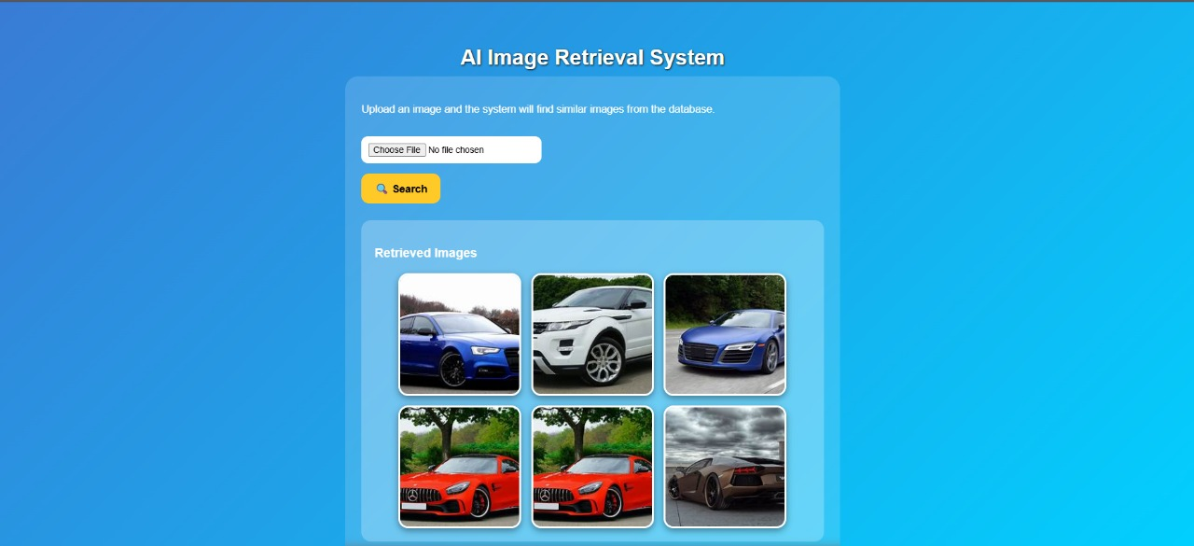
RESULTS

Slide 14
CONCLUSION
Designed an AI-powered CBIR framework that combines color, texture, and shape features for comprehensive image representation.
Eliminates redundant data to improve retrieval accuracy, processing speed, and scalability for large datasets.
Enhances robustness against changes in lighting, scale, and noise, outperforming traditional single-feature CBIR approaches.
Tested on benchmark datasets (Corel-1000, Caltech-256, ImageNet subsets) to validate superior performance.
Potential applications include:
  Medical imaging: retrieving similar X-rays or MRIs for diagnostics
  Surveillance: matching query images with crime databases
  E-commerce: visual product search
  Digital libraries: fast multimedia retrieval

Slide 15
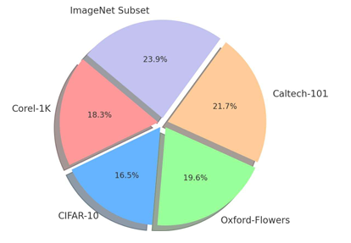
CONCLUSION

Slide 16
FUTURE SCOPE
Deep Learning Integration: Incorporate CNN embeddings or transformer-based vision models (e.g., Vision Transformers) into the hybrid feature vector to enhance semantic understanding.
Adaptive Optimization: Develop dynamic hybrid strategies that combine GA, FA, and SI adaptively to outperform single-algorithm approaches.
Cross-Domain Retrieval: Extend the system to support cross-modal retrieval, such as retrieving images from text queries or multimodal inputs.
Real-Time Deployment: Optimize indexing methods (e.g., Approximate Nearest Neighbor Search) for fast, large-scale retrieval in commercial environments.
Privacy-Preserving Retrieval: Implement federated learning or secure indexing techniques to protect sensitive datasets while enabling safe retrieval.

Slide 17
REFERENCES
1. Swain, M. J., & Ballard, D. H. (1991). “Color Indexing.” International Journal of Computer Vision (IJCV), 7(1), 11–32.
2. Manjunath, B. S., & Ma, W. Y. (1996). “Texture Features for Browsing and Retrieval of Image Data.” IEEE Transactions on Pattern Analysis and Machine Intelligence (TPAMI), 18(8), 837 842.
3. Rui, Y., Huang, T. S., & Chang, S. F. (1999). “Image Retrieval: Current Techniques, Promising Directions and Open Issues.” Journal of Visual Communication and Image Representation, 10(1), 39–62.
4.Datta, R., Li, J., & Wang, J. Z. (2005). “Content-Based Image Retrieval: Approaches and Trends of the New Age.” ACM Computing Surveys (CSUR), 40(2), 1–60.
5.Lowe, D. G. (2004). “Distinctive Image Features from Scale-Invariant Keypoints.” International Journal of Computer Vision (IJCV), 60(2), 91–110.
6.Smeulders, A. W. M., Worring, M., Santini, S., Gupta, A., & Jain, R. (2000). “Content-Based Image Retrieval at the End of the Early Years.” IEEE Transactions on Pattern Analysis and Machine Intelligence (TPAMI), 22(12), 1349–1380.

